Slide 1
Overview of Project Management
Unit - I

Slide 2
Contents
Project Management – Definitions
Factors influencing Project Management
Project Management Activities
Project Management life-cycle
Role of Project Manager, Team members, Client & Users in project management.

Slide 3
Project - Definition
Definition: A project is “a temporary endeavor undertaken to accomplish a unique product or service”.
Definition: Unique process consisting of a set of coordinated and controlled activities with start and finish dates, undertaken to achieve an objective conforming to specific requirements, including constraints of time, cost, quality and resources.
Definition: Projects are unique transient endeavors undertaken to achieve a desired outcome.
Definition: A project is a sequence of unique, complex, and connected activities that have one goal or purpose and that must be completed by a specific c time, within budget, and according to specification.
Definition: a project is defined as a specific, finite activity that produces an observable and measurable result under certain preset requirements.

Slide 4
Project – Attributes/Characteristics
A Project has clear objective(s);
A Project is purposeful as it has a rational and measurable purchase.
A Project is logical as it has a certain life-cycle.
A Project has a scope and unique purpose.
A Project has time, cost, quality and resource constraints.
A Project involves change and uncertainty.
A Project should have a primary sponsor and/or customer.
A Project involves team of people;
A Project is structured as it has interdependencies between its tasks and activities.

Slide 5
Project Management
A simple definition of project management includes a handful of key premises:
Project management is no small task.
Project management has a definite beginning and end. It's not a continuous process.
Project management uses various tools to measure accomplishments and track project tasks. These include Work Breakdown Structures, Gantt charts and PERT charts.
Projects frequently need ad-hoc resources rather than dedicated, full-time positions common in organisations.
Project management reduces risk and increases the chance of success.
The Project Management Institute (PMI) formally defines project management as follows: “The application of knowledge, skills, tools and techniques to project activities to meet the project requirements.”
Defination: The art of organising, leading, reporting and completing a project through people.

Slide 6
Project Management
Project management is a set of tools, templates, and processes designed to answer the following six questions:
What business situation is being addressed by this project?
What does the business need to do?
What will you do?
How will you do it?
How will you know you did it?
How well did you do?
Often, a triangle, commonly called the "triple constraint", is used to summarise project management. The three most important factors are time, cost and scope.

Slide 7
The Triple Constraint
Every project is constrained in different ways by its
Scope goals: What is the project trying to accomplish?
Time goals: How long should it take to complete?
Cost goals: What should it cost?
These three variables form the sides of a triangle and are an interdependent set. If any one of them changes, at least one other variable must also change to restore balance to the project.

Slide 8
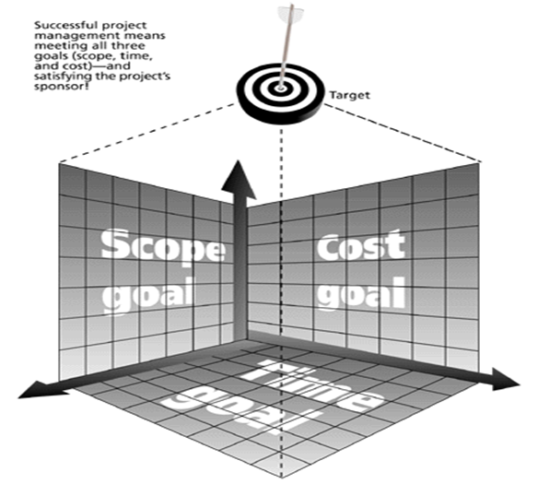
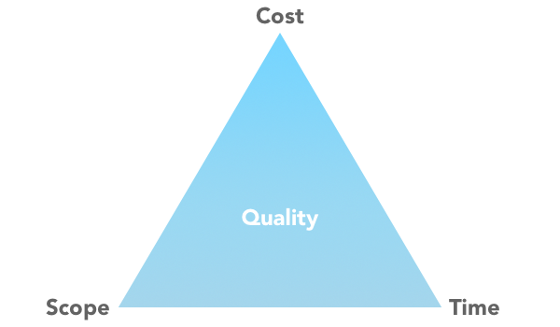
The Triple Constraint of PM

Slide 9
The Triple Constraint
The greatest challenge of project management is the integration and control of the three principal interrelated components of each single project.
Projects must be within cost.
Projects must be delivered on time.
Projects must be in scope.
Projects must meet customer quality requirements.
The cost, time, quality triangle implies a tension between the three components such that if any one of the components was to be changed, then it would have an impact on one, or both, of the others.
More recently this has given way to a project management diamond with cost, time, scope and quality as the four vertices and customer expectations as a central theme. No two customer expectations are the same so you must ask what their expectations are.

Slide 10
The Triple Constraint
Consider the following constraints that operate on every project:
Scope
Quality
Cost
Time
Resources
Risk
Except for Risk these constraints form an interdependent set—a change in one constraint can require a change in one or more of the other constraints in order to restore the equilibrium of the project.
In this context, the set of fi ve parameters form a system that must remain in balance for the project to be in balance. Because they are so important to the success or failure of the project, each parameter is discussed individually in this section.

Slide 11
Scope
Scope is a statement that defines the boundaries of the project.
It tells not only what will be done, but also what will not be done.
In the information systems industry, scope is often referred to as a functional specification. In the engineering profession, it is generally called a statement of work.
Scope may also be referred to as a document of understanding, a scoping statement, a project initiation document, or a project request form. Whatever its name, this document is the foundation for all project work to follow. It is critical that the scope be correct

Slide 12
Quality
The following two types of quality are part of every project:
Product quality—The quality of the deliverable from the project. As used here “product” includes tangible artifacts like hardware and software as well as business processes.
Process quality—The quality of the project management process itself. The focus is on how well the project management process works and how it can be improved. Continuous quality improvement and process quality management are the tools used to measure process quality
A sound quality management program with processes in place that monitor the work in a project is a good investment. Not only does it contribute to client satisfaction, but it helps organizations use their resources more effectively and efficiently by reducing waste and revisions. Quality management is one area that should not be compromised.
The payoff is a higher probability of successfully completing the project and satisfying the client.

Slide 13
Cost
The dollar cost of doing the project is another variable that defi nes the project. It is best thought of as the budget that has been established for the project.
This is particularly important for projects that create deliverables that are sold either commercially or to an external customer.

Slide 14
Time
The client specifies a time frame or deadline date within which the project must be completed.
To a certain extent, cost and time are inversely related to one another. The time a project takes to be completed can be reduced, but costs increase as a result

Slide 15
Resources
Resources are assets such as people, equipment, physical facilities, or inventory that have limited availabilities, can be scheduled, or can be leased from an outside party.
Some are fi xed; others are variable only in the long term.
In any case, they are central to the scheduling of project activities and the orderly completion of the project

Slide 16
Risk
Risk is not an integral part of the scope triangle, but it is always present and spans all parts of the project both external as well as internal, and therefore it does affect the management of the other fi ve constraints.

Slide 17
Barriers, Risks and Issues That Affect Project Success
Many things can go wrong in project management. Any barriers, risks and issues can affect every phase and process of project management. Here are just some of the things that can possibly go wrong:
Poor communication
Disagreement
Misunderstandings
Uncertain weather
Union strikes
Personality conflicts
Poor management
Poorly defined goals and objectives

Slide 18
Barriers, Risks and Issues That Affect Project Success
A good project management discipline will not eliminate all risks, issues and surprises - but it will provide standard processes and procedures to deal with them and help prevent the following:
Projects finishing late, exceeding budget and not meeting customer expectations
Inconsistency between the processes and procedures used by project managers, leading to the favoring of some project managers more than others
Successful projects, despite a lack of planning, achieved through high stress levels, goodwill and significant amounts of overtime
Project management being seen as not adding value and as a waste of time and money
Unforeseen internal and external events impacting the project

Slide 19
Project Management Activities
Software Project Management consists of many activities, that includes planning of the project, deciding the scope of product, estimation of cost in different terms, scheduling of tasks, etc.
The list of activities are as follows:
Project planning and Tracking
Project Resource Management
Scope Management
Estimation Management
Project Risk Management
Scheduling Management
Project Communication Management
Configuration Management

Slide 20
Project Management Life Cycle (PMLC)
A project management life cycle (PMLC) is a sequence of processes that includes:
Project Initiation
Project Planning
Project Execution
Project Monitoring and controlling
Project Closing
the projects to which it applies.
A valid PMLC always starts with a scoping process and ends with a closing process. All five of the processes must each be done at least once and may be repeated any number of times in some logical order.

Slide 21
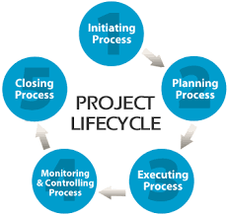
PMLC

Slide 22
Project Initiation
Initiation is first phase of project management life cycle where the feasibility and the business value of the project are determined.
The key outcome of the Initiating phase is our "Project Charter"! It is the bible of your Project!
Before we undertake any endeavor, we perform certain background checks, initial research, execution feasibility, and commercial viability and then decide if it should be undertaken at all. And exactly that is what is covered in our Project Charter :-
Project constraints and Problem statement
Goals / Projected Benefits
Identify Stakeholders
Project Scope (In-scope and Out-of-scope items)
Identifying Deliverables
Identifying Risks
Defining project resources, cost &budget.
Identifying stakeholders

Slide 23
Project Initiation
It explains :-
- Why a project was undertaken? What problems need to be addressed?
- What specific strategic gaps and initiatives need to be served?
- What needs, objectives and profits were served by this project?
- Who are the key stakeholders, sponsors and project team?
- What are the roles and responsibilities of each person associated with the project?
- What does the project entail? What will be exactly delivered and left out of the deliverables?
- What is to be delivered, at what time and within how much cost?
- And lastly who is in charge and authorized to run the project?

Slide 24
Project Initiation
The other activities involved in initiating process group are:
Assigning the project manager
Determining the stakeholder needs, expectations and high-level requirements
Define the project success criteria
Identify particular budget for particular stage
Make sure that the project is aligned with the organizations strategic goal

Slide 25
Project Planning
FAILING to PLAN is PLANNING to FAIL.
Planning is the second yet most important phase in the project management life cycle. Project planning is at the heart of the project life cycle and tells everyone involved where you’re going and how you’re going to get there.
The planning phase is when the project plans are documented, the project deliverables and requirements are defined, and the project schedule is created.
The plans created during this phase will help you manage time, cost, quality, changes, risk, and related issues. They will also help you control staff and external suppliers to ensure that you deliver the project on time, within budget, and within schedule.

Slide 26
Project Planning
Steps for the project planning phase may include the following:
Creating a project plan: Identify the project timeline, including the phases of the project, the tasks to be performed, and possible constraints
Creating workflow diagrams: Visualize your processes to make sure team members clearly understand their role in a project
Estimating budget and creating a financial plan: Use cost estimates to determine how much to spend on the project to get the maximum return on investment
Gathering resources: Build your functional team from internal and external talent pools while making sure everyone has the necessary tools (software, hardware, etc.) to complete their tasks
Anticipating risks and potential quality roadblocks: Identify issues that may cause your project to stall while planning to mitigate those risks and maintain the project’s quality and timeline
Holding a project kickoff meeting: Bring your team on board and outline the project so they can quickly get to work

Slide 27
Project Execution
This is the phase when the project starts taking it shape.
The programmers are working on coding, web designers with the graphic material, status and performance reports are made by project managers. This phase is also called implementation phase.
Here are some of the important things are being taken care of in the implementation phase.
Report progress: Regular updates and status reports are required when the project is in the execution stage. It’s important to provide the required information in the right format and identify the issues as well. These resources will prove beneficial in the times of a crisis.
Hold weekly meetings: Weekly meetings can save your team deviating from the important activities. Clear agendas should be set for the meeting so that no time is wasted as team members are already well-aware what the meeting is for and the overall productivity doesn’t get affected.
Manage problems: As the project is in motion, problems are bound to happen. You can face issues like quality, time management, the decline in a team’s morale that can threaten the success of a project.

Slide 28
Monitoring and Controlling
In the project management process, the third and fourth phases are not sequential in nature. This phase runs simultaneously with project execution, thereby ensures that objectives and project deliverables are met.
As a project manager, you can make sure that no one deviates from the original plan by establishing Critical Success Factors (CSF) and Key Performance Indicators (KPI).
During the monitoring phase of project management, the manager is also responsible for quantitatively tracking the effort and cost during the process. This tracking not only ensures that the project remains within the budget but also is important for future projects.
Some of the common KPIs to measure project performance are:
Project objectives: If a project stays on schedule and desired budget, it’s an indication that it will meet the expectations of the decision-makers and clients.
Quality deliverables: This helps to determine if deliverables are being met or not.
Cost tracking: Project managers need to be accountable for the effort and cost of resources.
Project performance: Any changes made in the project due to scope-creep or other unforeseen circumstances are taken into account while measuring the overall progress of the project.

Slide 29
Project Closure
The closing phase is a critical step in the project management life cycle. It signals the official end of the project and provides a period for reflection, wrap-up, and organization of materials.
Generally, once the project is completed and delivered, the effective project managers set aside some time to identify the strengths, valuable team members are recognized, what went wrong, how it can be rectified, and what are the takeaways from the project.
How a project manager closes the project?
Project performance is evaluated If there are elements that went really well or something didn’t go as planned, it is the time to bring them up. The project manager brings out the performance reports and evaluates how well the project has performed.
Closing the project with a team meeting The final team meeting is a great way to reflect how well the project went and share the takeaways with the team members so that the future projects can be handled in a better way.

Slide 30
Role of Project Manager
The role of the project manager is one of great responsibility. The project manager's job is to direct, supervise and control the project from beginning to end. Project managers should not carry out project work - managing the project is enough. Here are some of the activities a project manager undertakes:
The project manager must define the project, reduce it to a set of manageable tasks, obtain appropriate resources and build a team to perform the work.
The project manager must set the final goal of the project and motivate the project team to complete the project on time.
The project manager must inform all stakeholders of progress on a regular basis.
The project manager must assess and monitor risks to the project and mitigate them.
No project ever goes quite as planned. Project managers must learn to adapt to and manage change.

Slide 31
Skills of Project Manager
A project manager must have a range of competencies: Leadership, People management (customers, suppliers, functional managers and project team), Effective communication (verbal and written), Influencing, Negotiation, Conflict management, Planning, Contract management, Estimating, Problem solving, Creative thinking and Time management
Project managers bear ultimate responsibility for making things happen. Traditionally, they have carried out this role as mere implementers. To do their jobs they needed to have the necessary administrative and technical competencies.
Today they play a far broader role. In addition to the traditional skills, they need to have business skills, customer relations skills, and political skills.
Psychologically, they must be results-oriented self-starters with a high tolerance for ambiguity because little is clear-cut in today's business environment. Shortcomings in any of these areas can lead to project failure.

Slide 32
Skills of Project Manager
A Good Project Manager
–Takes ownership of the whole project
–Is proactive not reactive
–Adequately plans the project
–Is Authoritative (NOT Authoritarian)
–Is Decisive
–Is a Good Communicator
–Manages by data and facts not uniformed optimism
–Leads by example
–Has sound Judgement
–Is a Motivator
–Is Diplomatic
–Can Delegate

Slide 33
Customer Role
A customer, often also referred to as client, can be a person or an organization that orders and buys products or services that a business offers.
In project management, the customer is the one defining the requirements of the project and often setting the parameters such as budget and deadlines. The customer, therefore, influences the constraints of a project heavily and plays an active part in the project’s process.
Customers' role includes tasks such as:
approving the project plan
requesting changes to the project
approving or declining the product or service at the end of a project.
You can distinguish between two types of customers:
Internal customer: from the same organization
External customer: belongs to another organization

